Slide 1
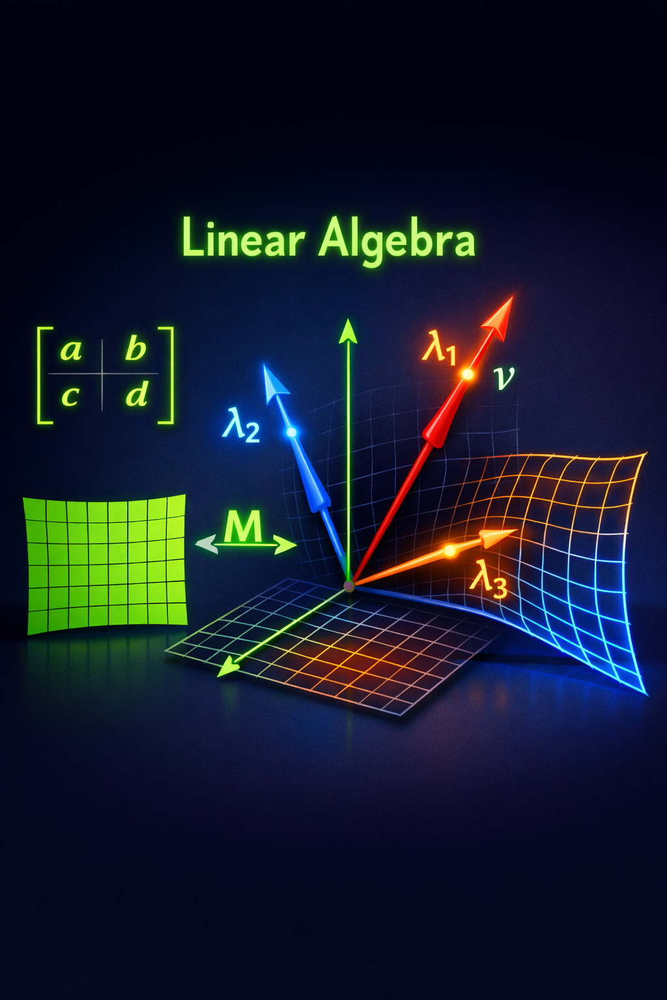



Slide 2
Learning Path: Concept to Application
For Each Concept, We'll Cover:
1. Topic
What concept are we learning?
2. Definition
Precise mathematical definition and properties
3. Example
Concrete real-world example with numbers
4. Visual
Diagram showing the concept geometrically
5. ML Application
How is this ACTUALLY used in machine learning?
- Algorithm
Which ML algorithm uses this?
- Why
Why is this concept critical there?
- Benefit
What performance improvement does it give?
- Code
Actual Python implementation or library usage

Slide 3
Vectors
What is a Vector?
An ordered list of numbers (components) representing:
• Position in space
• Direction and magnitude
• Data features
• Weights in networks
Notation: v = [v1, v2, ..., vn]
|v| = sqrt(v1² + v2² + ... + vn²)
Vector Operations
Dimension
Number of components
Unit Vector
Magnitude = 1
Addition
Element-wise sum
Scaling
Multiply by scalar
Dot Product
Similarity measure
Orthogonal
Perpendicular, independent

Slide 4
Vectors: Student Profile Example
Example: Each Student as a Feature Vector
Alice = [Age=20, GPA=3.8, Hours=5, Score=92, Projects=4]
Magnitude: |Alice| = sqrt(20² + 3.8² + 5² + 92² + 4²) = sqrt(8919.44) ≈ 94.4
Addition (combine profiles): Alice + Bob = [20+21, 3.8+3.2, ...]
Scaling (double effort): 2 × [Hours] = 2 × 5 = 10 hours
Unit Vector (normalize): Alice/|Alice| = [0.212, 0.040, 0.053, 0.975, 0.042]

Slide 5
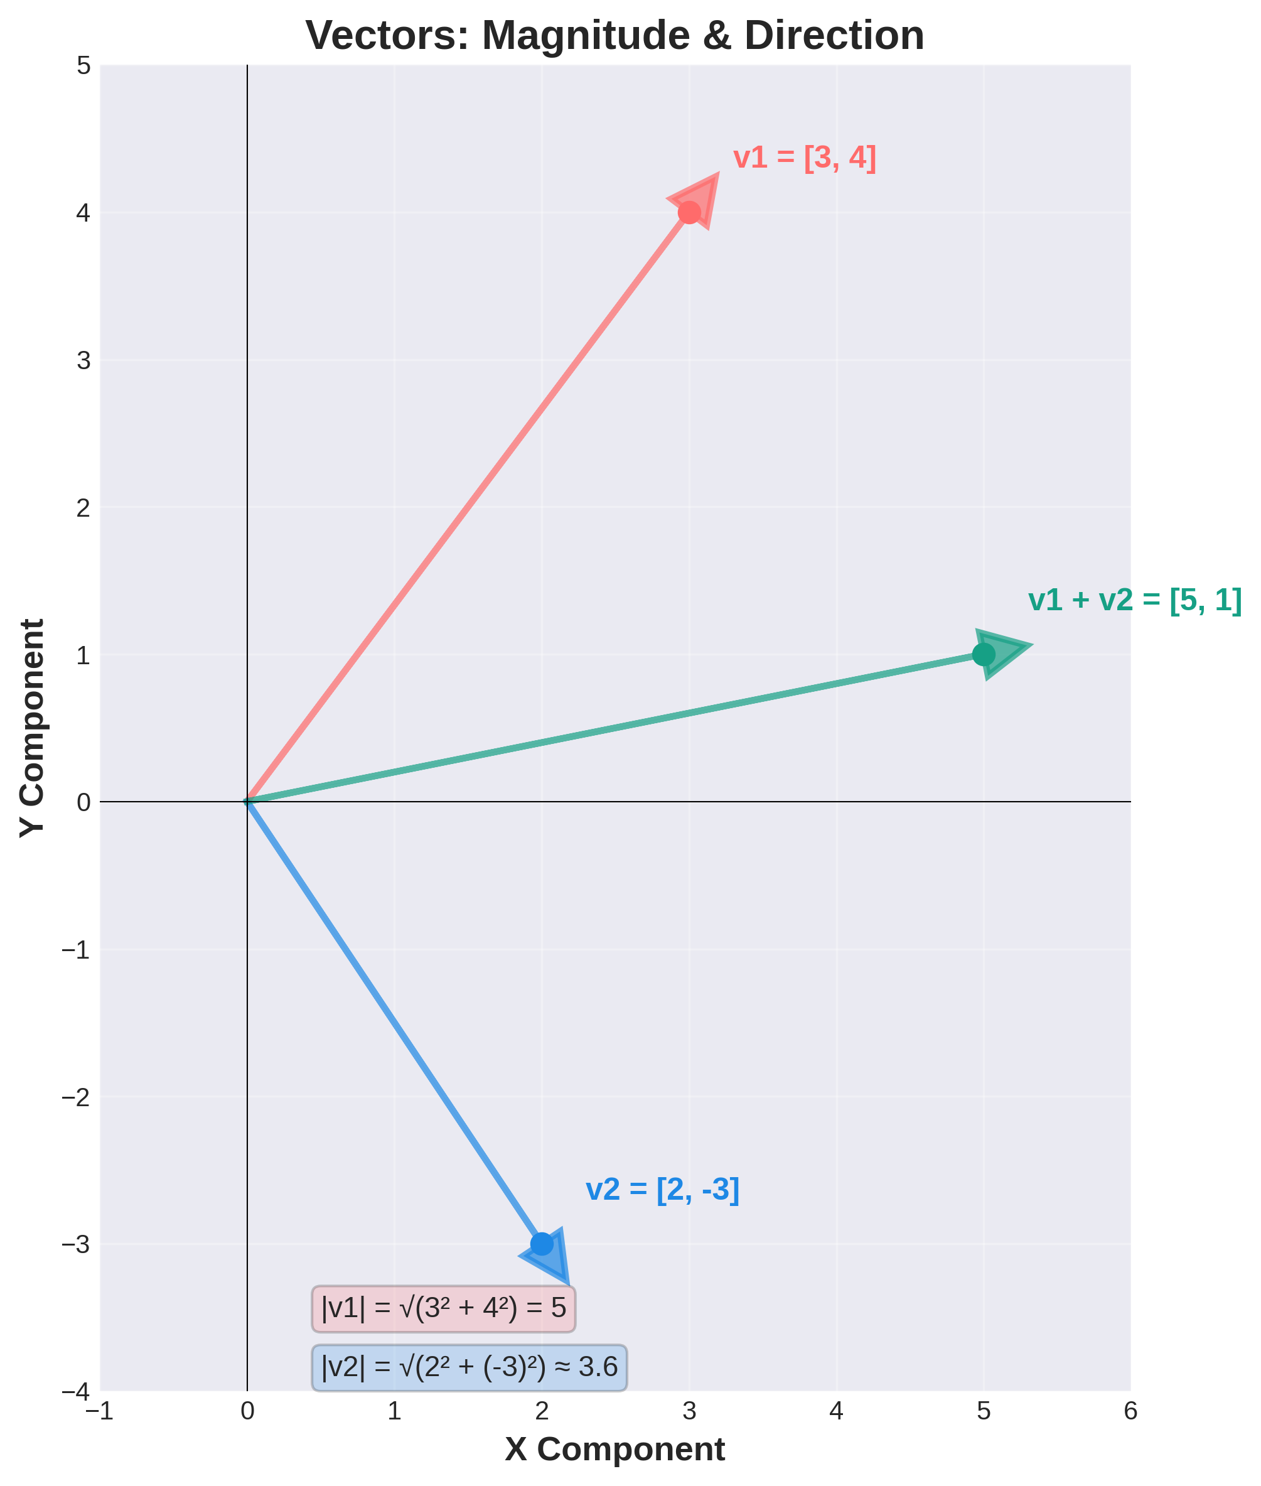
Vectors: Visual Representation

Slide 6
Vectors in Machine Learning
How ML Uses Vectors
Every data point is a vector!
Image: [pixel_R, pixel_G, pixel_B, ...] (1000s of values)
Text: [word_freq_the, word_freq_and, ...] (embedding vectors)
Audio: [amplitude_1ms, amplitude_2ms, ...] (sound waves)
Sensor: [temp, pressure, humidity, ...] (IoT data)
Algorithms Using Vectors
K-Means Clustering
Finds closest vectors using distance
Neural Networks
Transforms input vectors through layers
KNN
Finds k nearest neighbor vectors
Embeddings
Maps words/images to vector space
Code Example: import numpy as np | x = np.array([0.5, 0.3, 0.8]) | magnitude = np.linalg.norm(x) | # [sklearn, tensorflow, pytorch all work with vectors]

Slide 7
Dot Product
What is Dot Product?
Multiply corresponding components and sum:
v · u = v1*u1 + v2*u2 + ... + vn*un
Result: Single number showing similarity
Geometric: v · u = |v| * |u| * cos(θ)
Interpretation
Large Positive
Vectors very similar (parallel)
Zero
Vectors independent (perpendicular)
Large Negative
Vectors opposite (anti-parallel)
Magnitude
v · v = |v|² (length squared)

Slide 8
Dot Product: Netflix Recommendation Example
How Netflix Recommends Movies (Simplified)
Movie Features: [Action, Comedy, Drama, Romance, Sci-Fi]
MovieA = [8, 3, 2, 1, 7] (Action/Sci-Fi heavy)
MovieB = [7, 2, 3, 2, 8] (Similar: Action/Sci-Fi)
MovieC = [1, 9, 2, 8, 0] (Comedy/Romance, different)
Similarity(A, B) = 8*7 + 3*2 + 2*3 + 1*2 + 7*8 = 56+6+6+2+56 = 126 ← HIGH!
Similarity(A, C) = 8*1 + 3*9 + 2*2 + 1*8 + 7*0 = 8+27+4+8+0 = 47 ← LOWER
Result: Netflix recommends B after A! (Higher dot product = more similar)

Slide 9
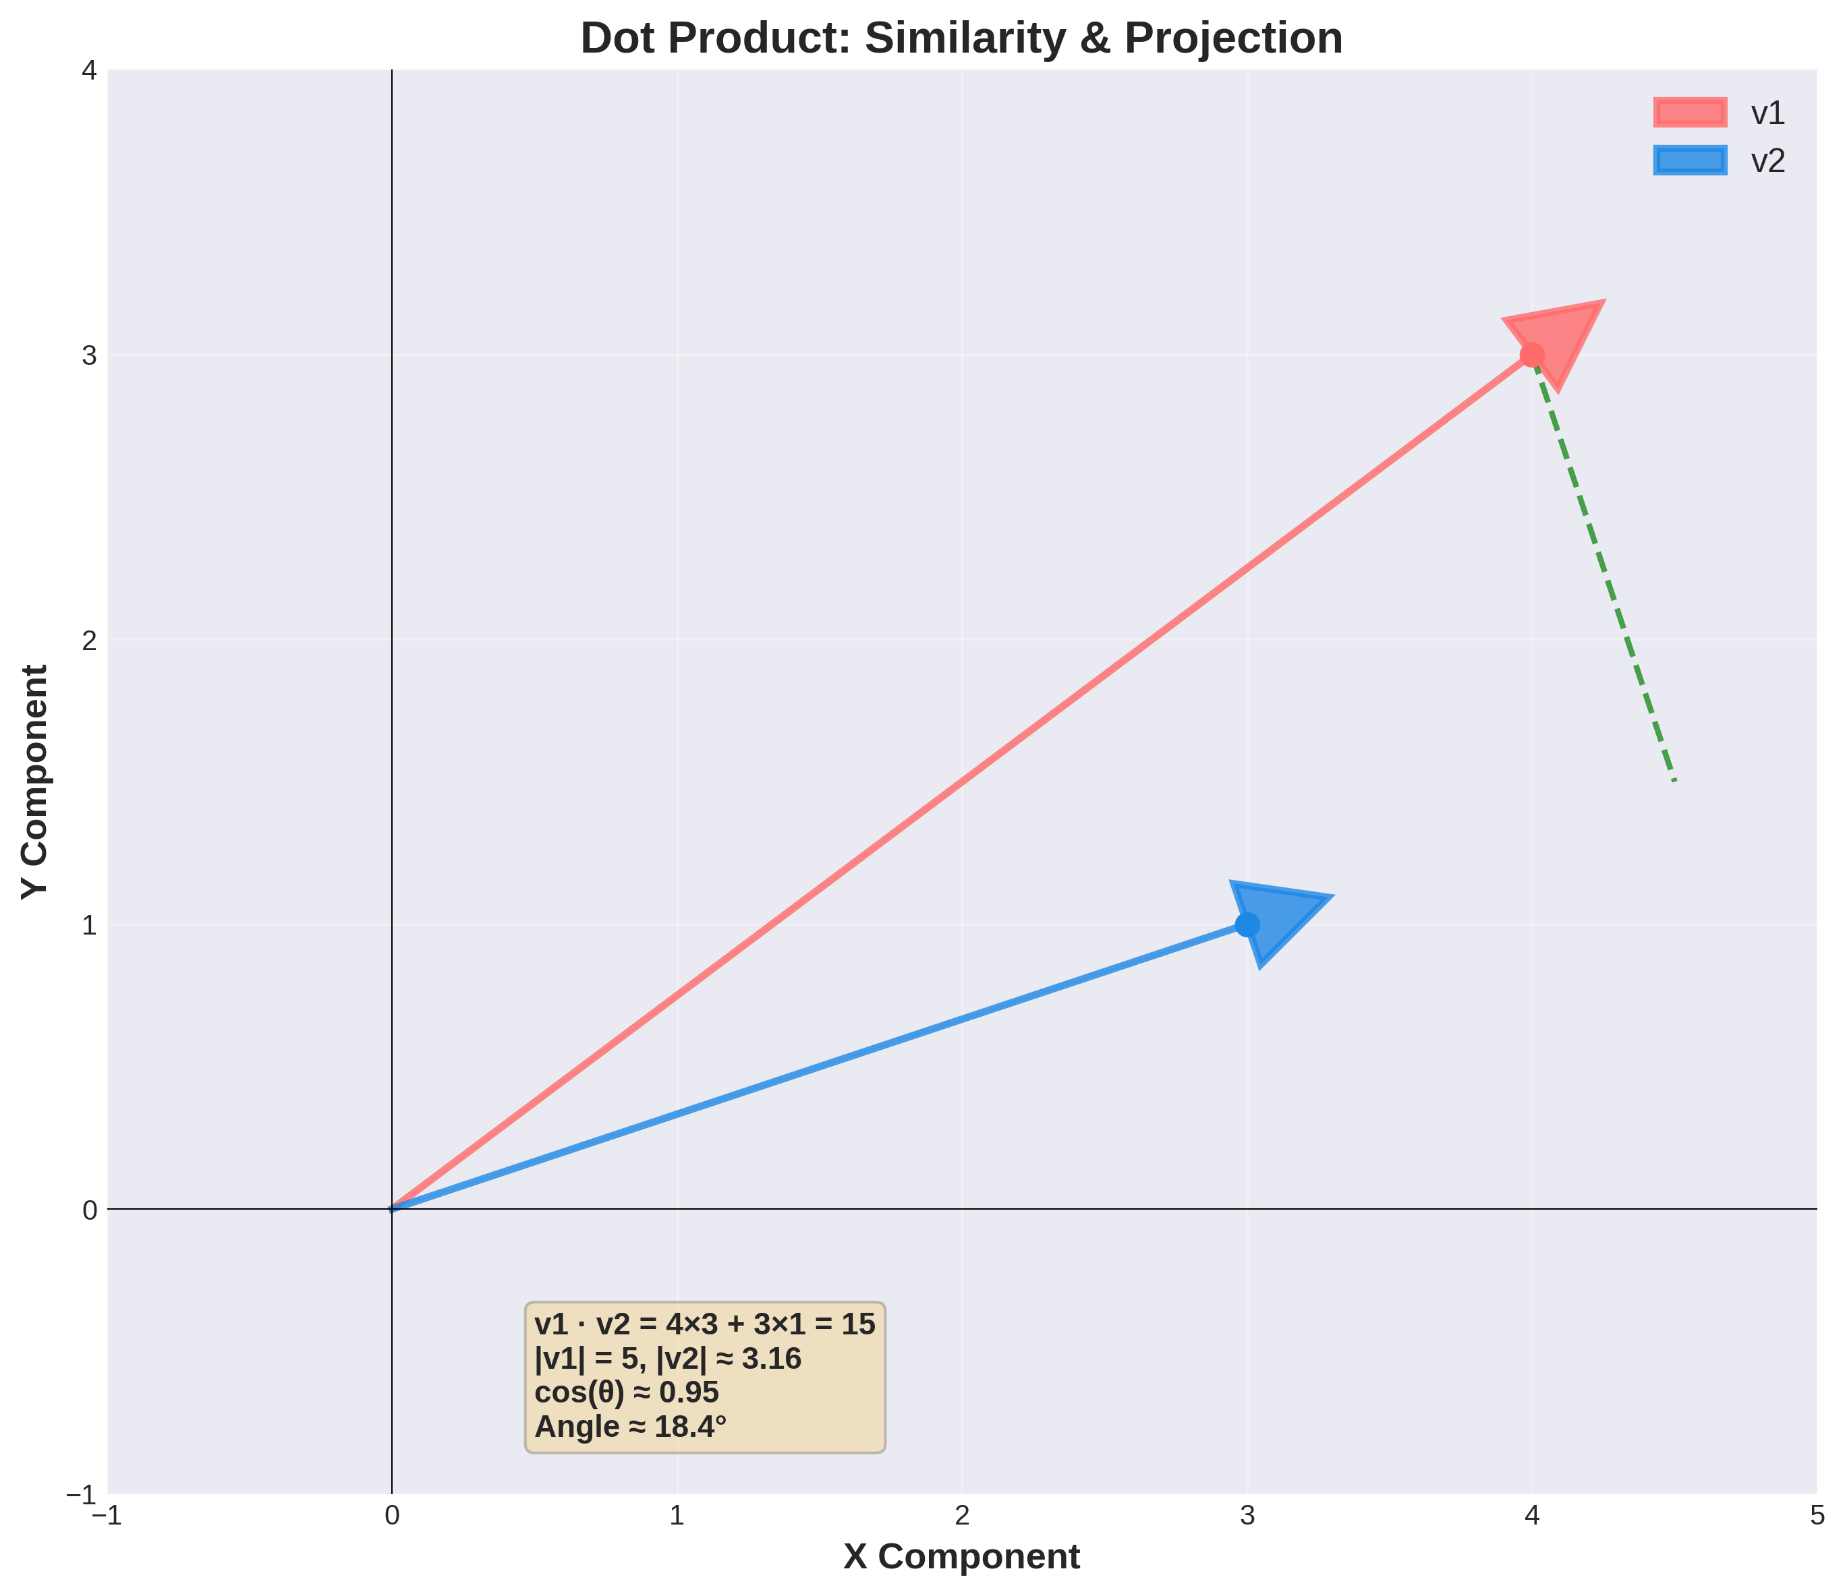
Dot Product: Visual Representation

Slide 10
Dot Product in Machine Learning
Neural Network Neuron
Every neuron computes:
output = weights · inputs + bias
Example:
w = [0.5, -0.2, 0.8]
x = [0.3, 0.1, 0.9]
output = 0.5*0.3 + (-0.2)*0.1 + 0.8*0.9
= 0.15 - 0.02 + 0.72 = 0.85
Real ML Applications
Transformer
Attention uses dot products (similarity between tokens)
Recommendation
Netflix: vector dot product for similarity
Image Search
Google: dot product of image embeddings
LLMs
ChatGPT: attention mechanism is dots of Q,K,V
Performance Impact: GPUs compute billions of dot products per second (billions times faster than CPU)! This is why deep learning exploded when GPUs became available.

Slide 11
Matrix Multiplication
What is Matrix Multiplication?
Multiply matrix A (M×N) by matrix B (N×P)
Result C (M×P) where:
C[i,j] = row i of A · column j of B
Dimension Rule:
(M×N) × (N×P) = (M×P)
Why It Matters
• Foundation of ALL neural networks
• Most computationally expensive operation
• Where 90% of GPU time is spent
• Determines inference latency
• Limits model size on devices
• GPUs designed to optimize this

Slide 12
Matrix Multiplication: Neural Network Example
3-Layer Neural Network Forward Pass
Input: x = [0.5, 0.3] (2D input image features)
Layer 1 (W1: 2×128): h1 = W1 × x (2×128 × 2×1 = 128×1)
Output: 128 hidden neurons
Layer 2 (W2: 128×64): h2 = W2 × h1 (128×64 × 128×1 = 64×1)
Output: 64 hidden neurons
Layer 3 (W3: 64×10): logits = W3 × h2 (64×10 × 64×1 = 10×1)
Output: 10 class probabilities (softmax)
Computation:
- Layer 1: 2 * 128 = 256 multiplications
- Layer 2: 128 * 64 = 8,192 multiplications
- Layer 3: 64 * 10 = 640 multiplications
Total: 9,088 mults per sample!
Batch of 32 samples: 291,000 multiplications
ImageNet (1000 classes): 128,000 multiplications per layer!

Slide 13
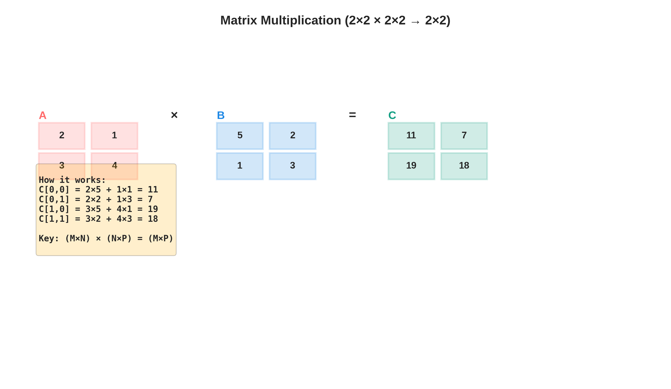
Matrix Multiplication: Visual Representation

Slide 14
Matrix Multiplication in Machine Learning
Model Performance
GPU Acceleration Makes This Possible:
CPU (1 core)
1 mult/cycle = 100M mults/sec
GPU (100 cores)
100 mults/cycle = 10B mults/sec
Speedup
100x faster on GPU!
ML Applications
Neural Networks
Every forward/backward pass is matrix multiply
Deep Learning
ResNet: 50+ layers of matrix multiply
Transformers
GPT: hundreds of matrix multiplications
Convolutional
CNN: convolution = sliding matrix multiply
Why Deep Learning Exploded: GPUs are optimized for matrix multiplication. Without efficient matrix ops, training ResNet-50 would take DAYS on CPU, but only HOURS on GPU!

